Slide 1


NJ Crime Unveiled:
Trends, Targets, and Tactics for 2022
Ebru Dagdelen

Slide 2


Introduction
Purpose:
Better understand crimes in NJ
Provide areas to increase protection to state governments and county governments
Questions:
Is there a specific identifier(age, race, sex) that is being targeted more?
What areas/counties of New Jersey have higher crime rates? What crimes occur most?
Is there a relationship of crimes and the time they occur?
Introduction:
What is the question behind your analysis? What is the purpose of your analysis?
Who benefits from exploring this question? Think of what groups of people or organizations may be interested in the results.

Slide 3

Methodology
→ Dataset was from CDE in the format of .csv
https://cde.ucr.cjis.gov/LATEST/webapp/#
→ Worked with:
Age, ethnicity, sex
Total number of offenses per county
Different types of offenses (person, property, society)
Hourly time intervals
Locations (home, bus, school…)
→ Tools: Jupyter Notebooks, google, chatGPT

Slide 4

Results
Primary Offense:
Larceny/Theft offenses were the most prevalent.
Temporal Patterns:
Peak crime periods:
Midnight to 12:59 a.m.
Noon to 12:59 p.m.
Common Crime Locations:
Residence/homes
Over 5 million inquiries
Demographic Targets:
Individuals aged 21 to 40 (44.6%)
White ethnic individuals (64.3%)
Females (50.6%)
High-Crime Counties:
Essex County: 24,817 offenses
Bergen County: 14,782 offenses
Atlantic County: 14,561 offenses

Slide 5
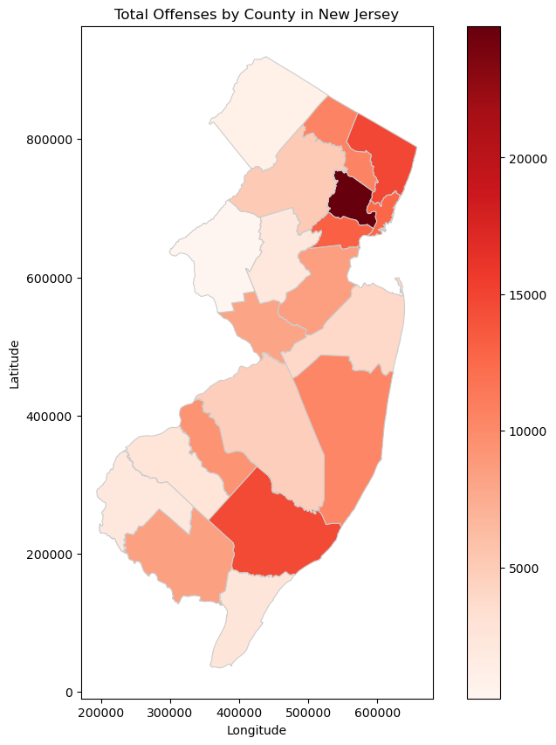
Bergen
Essex
Atlantic

Slide 6
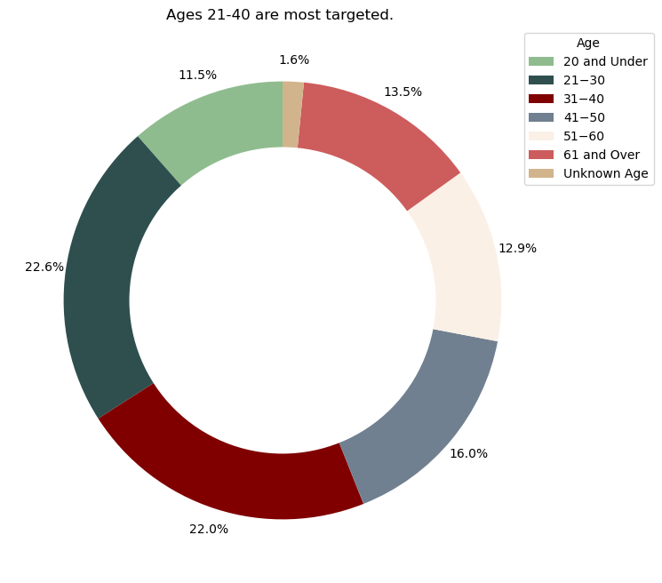
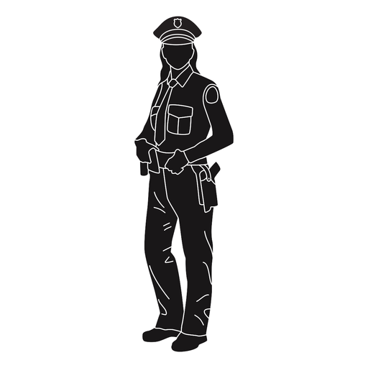

Slide 7
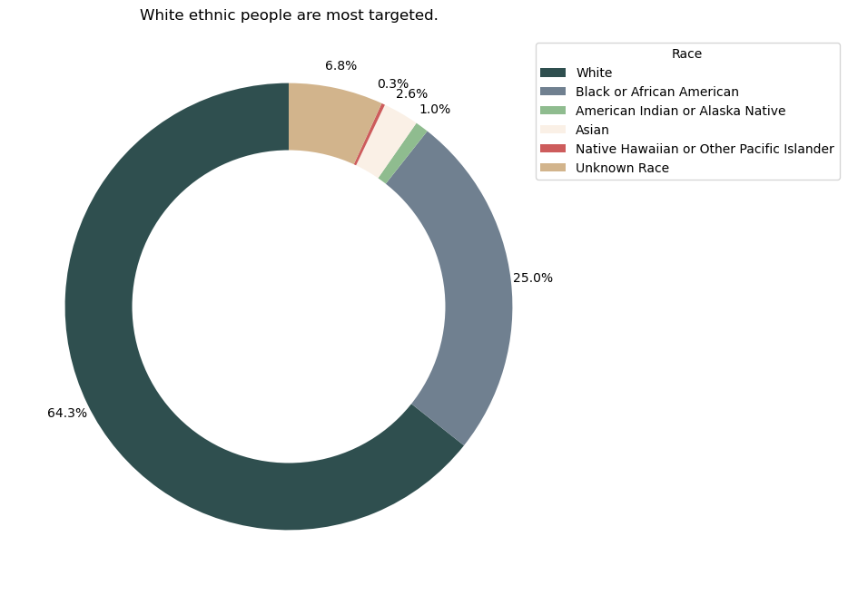

Slide 8
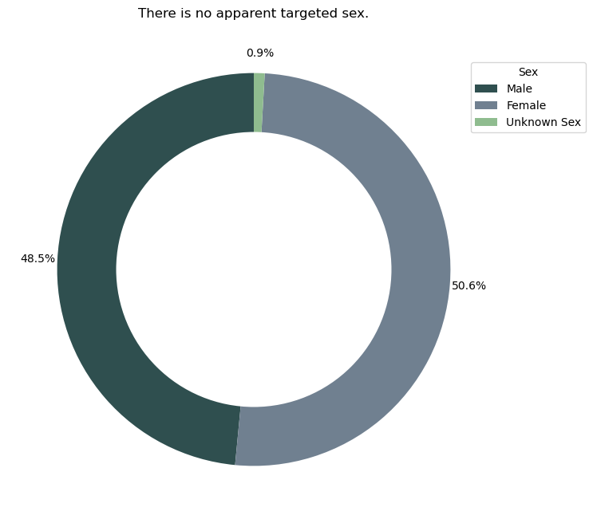
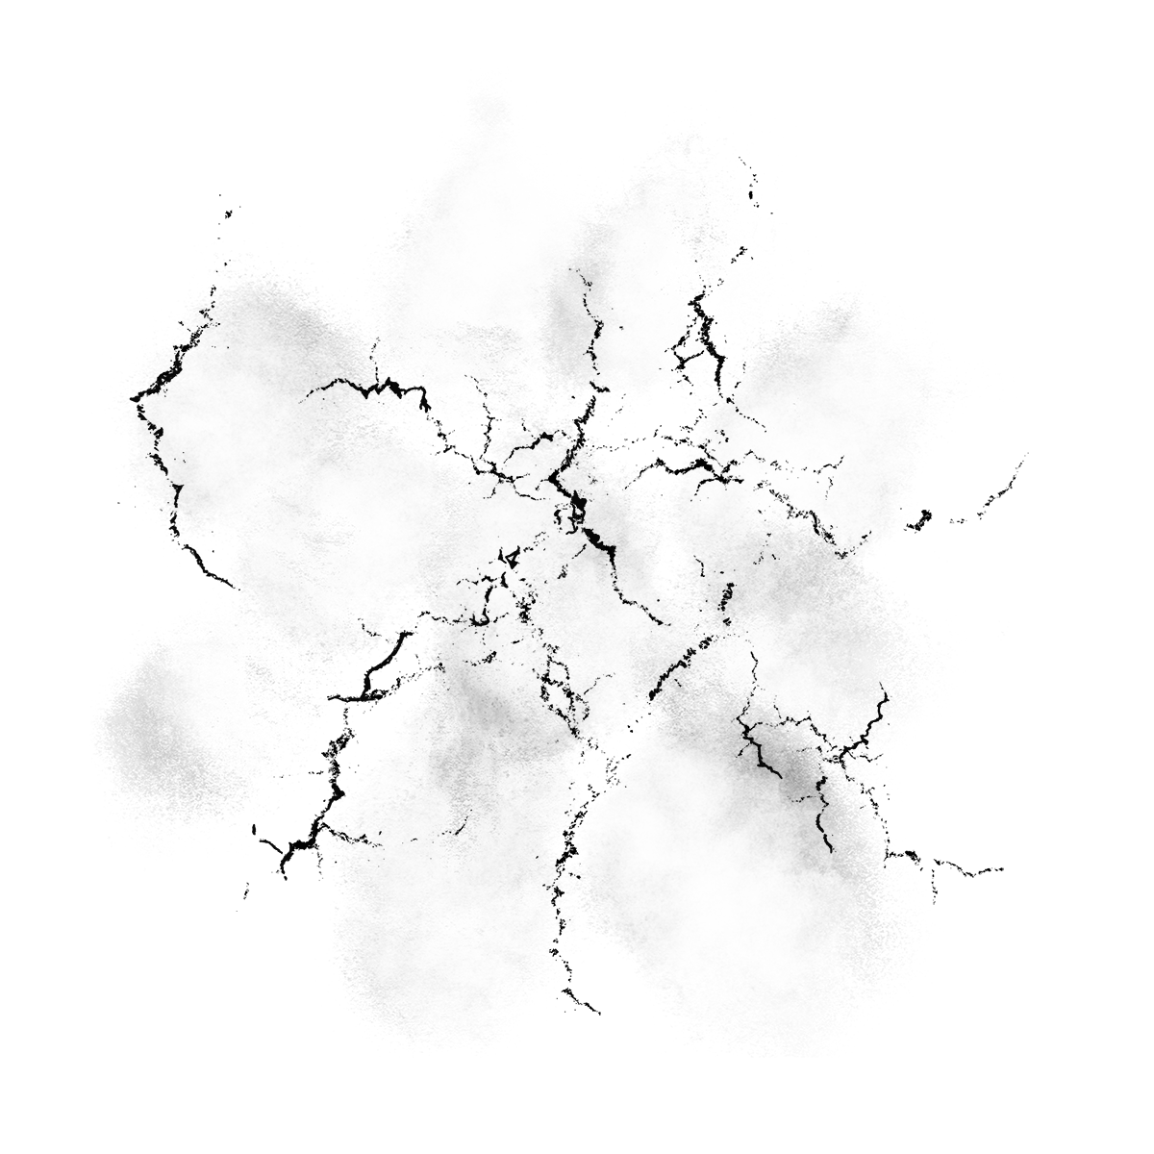
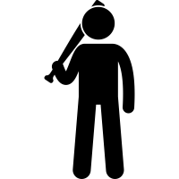

Slide 9
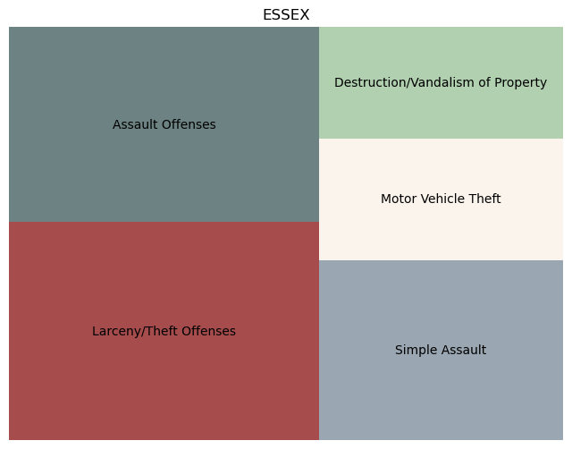
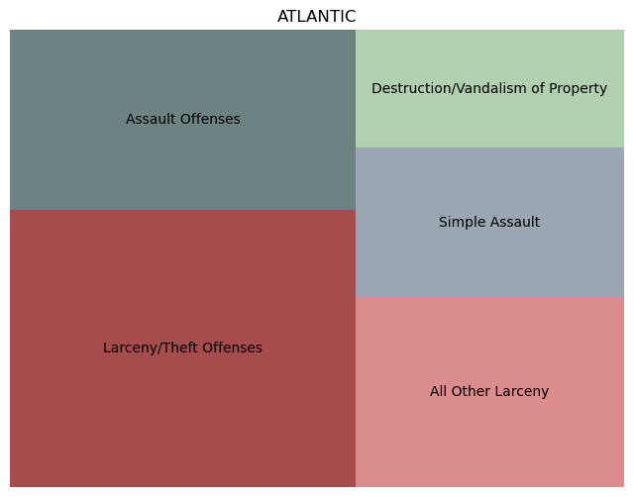
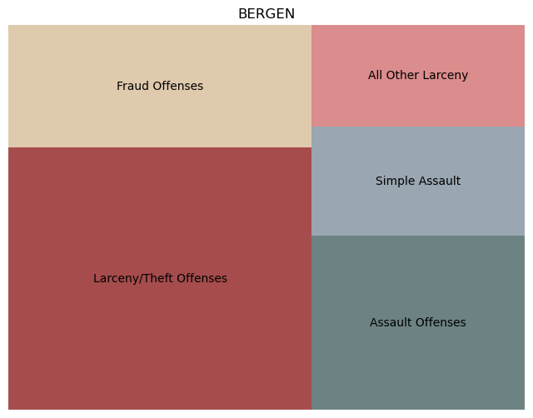

Slide 10
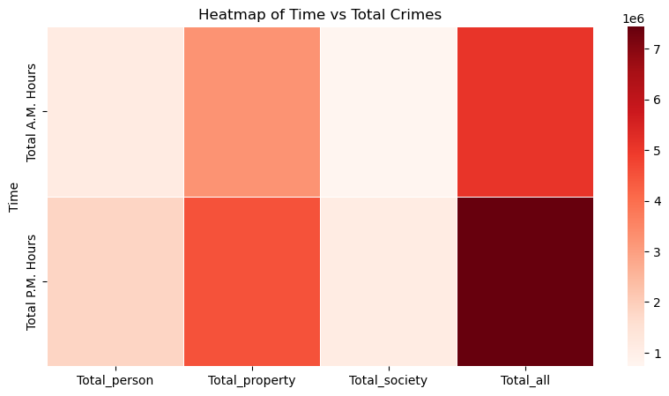
Heatmap for time

Slide 11
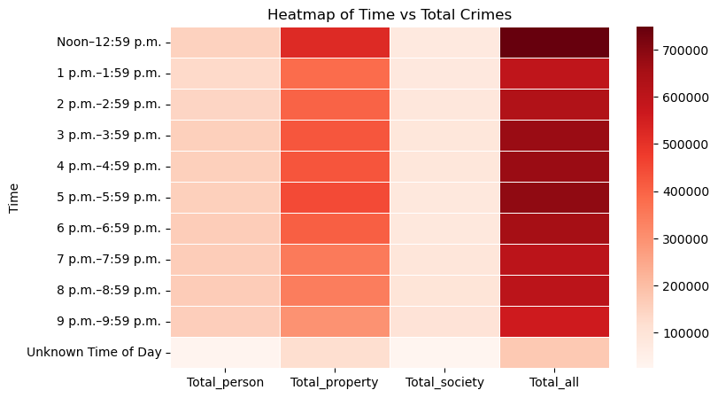

Slide 12
Results
Primary Offense:
Larceny/Theft offenses were the most prevalent.
Temporal Patterns:
Peak crime periods:
Midnight to 12:59 a.m.
Noon to 12:59 p.m.
Common Crime Locations:
Residence/homes
Over 5 million inquiries
Demographic Targets:
Individuals aged 21 to 40 (44.6%)
White ethnic individuals (64.3%)
Females (50.6%)
High-Crime Counties:
Essex County: 24,817 offenses
Bergen County: 14,782 offenses
Atlantic County: 14,561 offenses

Slide 13

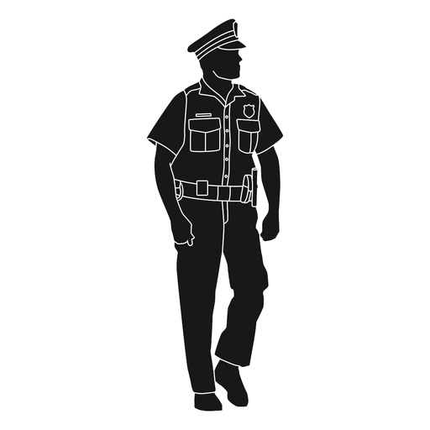
Future Work:
? What time of the year is crime more likely
? Has crime rates changed over the years, has COVID played a role in this
? For counties with higher crime rates, is there a targeted audience
? For counties with higher crime rates, is there a common location
? States levels

Slide 14

Appendix
Images:
https://943thepoint.com/can-a-cop-driving-in-front-of-you-legally-pull-you-over-in-new-jersey/
https://en.m.wikipedia.org/wiki/File:Handcuffs_icon_black.svg
https://en.wikipedia.org/wiki/Federal_Bureau_of_Investigation
https://www.iconfinder.com/icons/6244834/burglar_crime_criminal_man_robber_robbery_thief_icon
https://en.wikipedia.org/wiki/File:Logo_of_the_New_Jersey_State_Police.svg
https://www.vexels.com/merch/png/policeman/
https://pngimg.com/image/28708
https://www.pinterest.com/pin/717972365567942975/
https://thenounproject.com/icon/man-holding-a-baseball-bat-1926868/
https://www.pinterest.com/pin/671740100661418118/
https://www.njoag.gov/new-jersey-state-police/
https://www.pngall.com/damage-png/#google_vignette

Slide 15
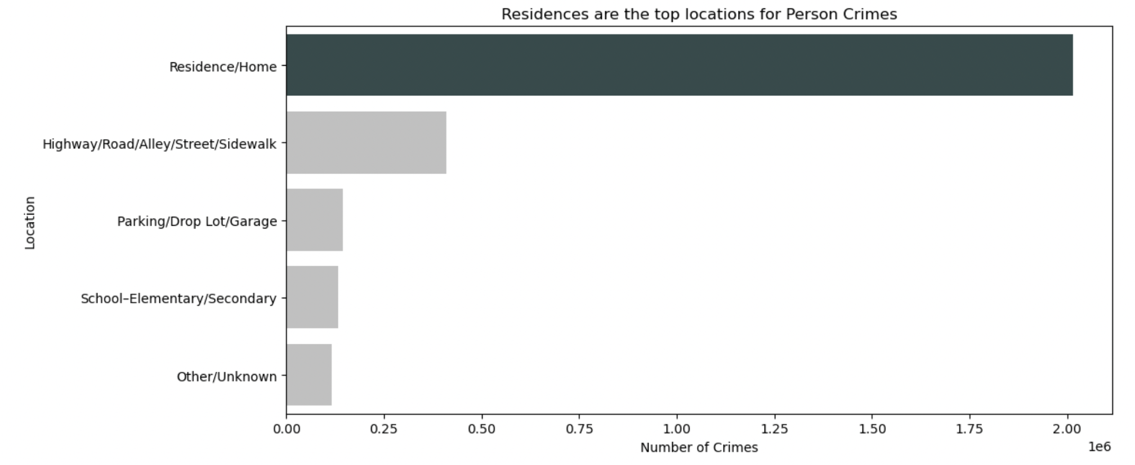

Slide 16
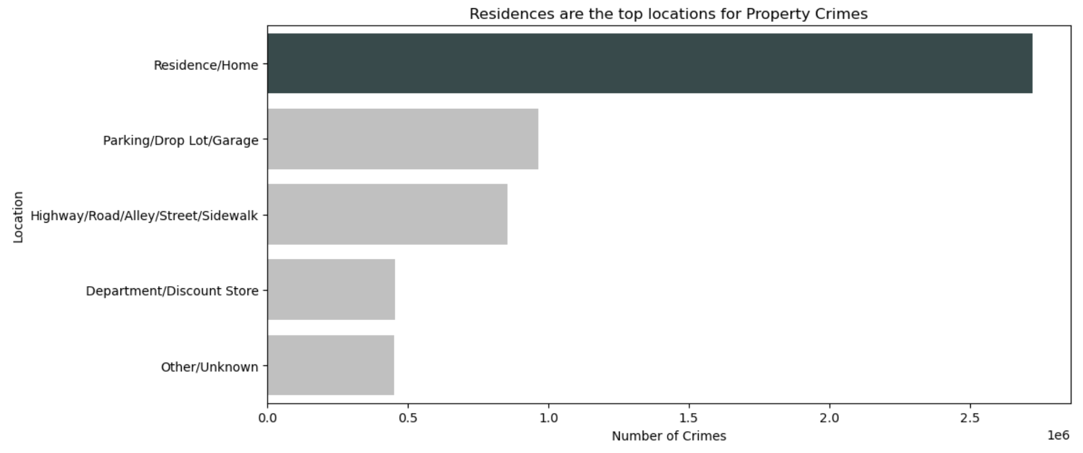

Slide 17
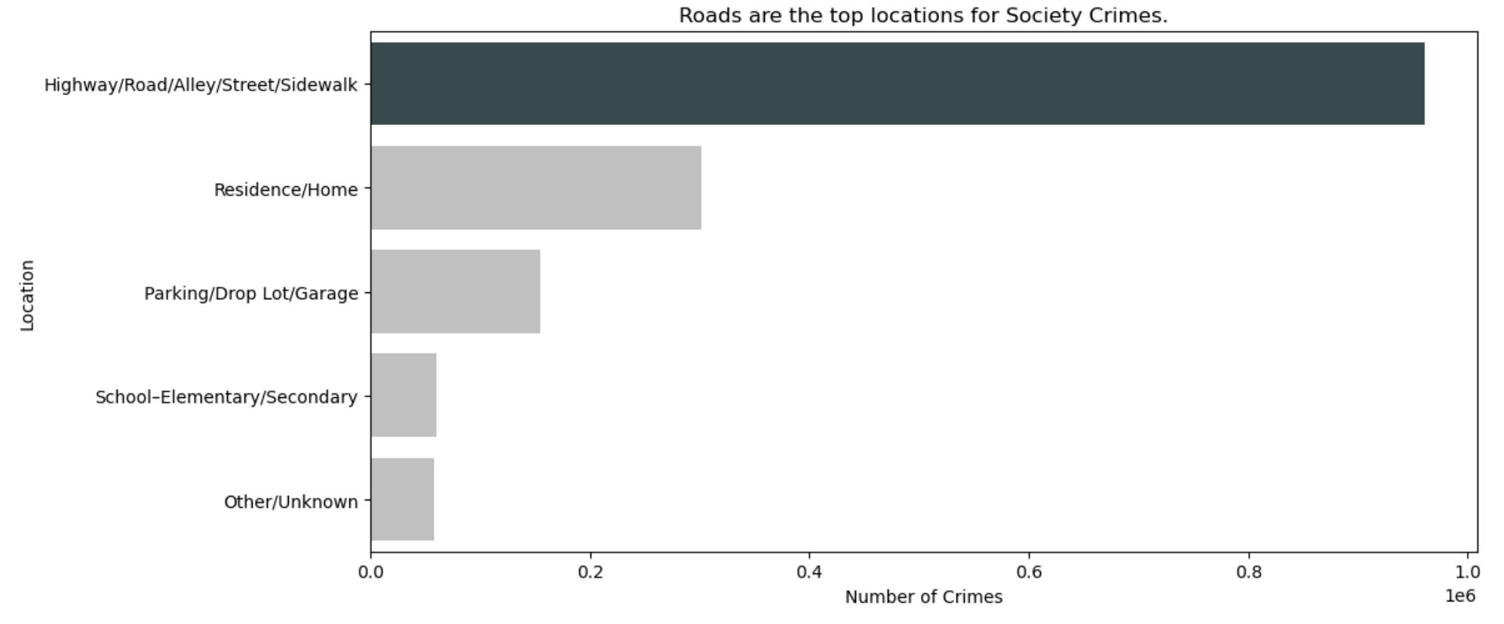

Slide 18
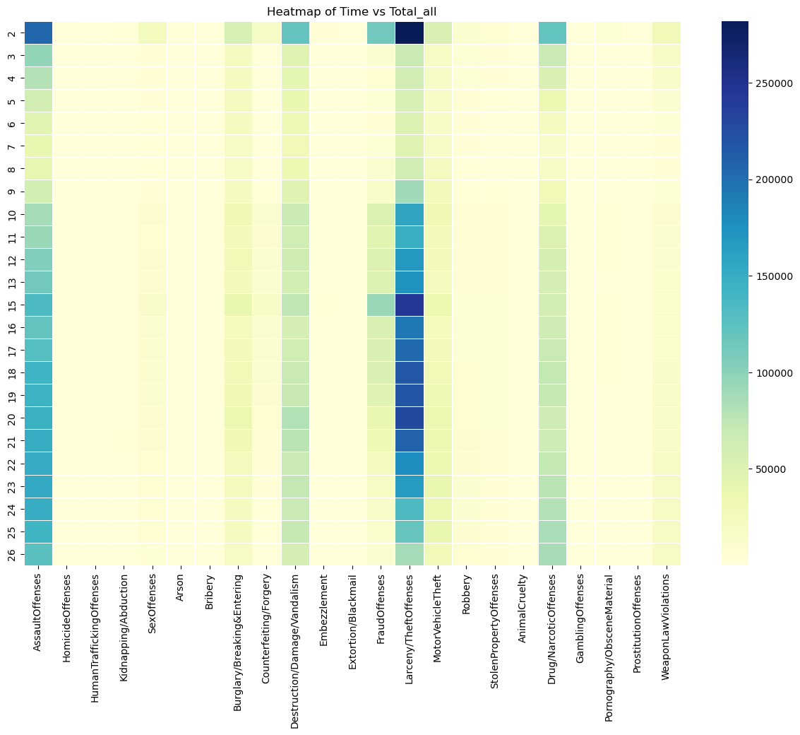

Slide 19
